Slide 1
Passerelles numériques
A Gateway for Life
Introduction to Database

Slide 2
Objectives
Data vs information
Know potential problem with list
Understanding the reasons for using a database
Understand how related tables avoid the problems associated with lists
Learn the elements of a database
Learn the purpose of a database management system (DBMS)
Understand the functions of a database application
Notes:
5mn

Slide 3
Data vs. Information
What is data?
It’s a raw fact (raw material) that need to be processed to be turned into something useful.
It comes in many forms such as numbers, words or descripts of things.
Ex: you buy a product from a store, data?
Date and time, product name, price, seller name, store location, and many more.
Notes:
5mn

Slide 4
Data vs. Information
What is information?
It’s the output or result of the processed data that is meaningful.
All the information is derived from processed data!
Ex: you buy a product from a store, what information?
Sub total, total amount, total quantity, all other information in your invoice.
Notes:
5mn

Slide 5
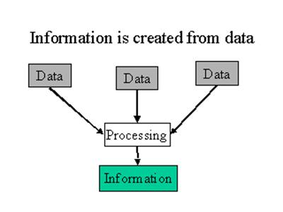
Data vs. Information

Slide 6
What is a Database?
Database is a repository/place to store data
Purpose:
Store data
Provide an organizational structure for data
Provide a mechanism for querying, creating, modifying and deleting data
Database can store information and relationship that are more complicated than a simple list
Notes:
-Store data: repository/place to store data
-org structure: not just a place but a way data could be placed
-mechanism to interact with data : CRUD
-real bz many hierarchical relationship among data: ex: many customers can place many orders or orders could be associated with a customer. Employee could work in only one department while one department could has many employees woking. And relational db allow us to model and represent thoses relationships
10mn

Slide 7
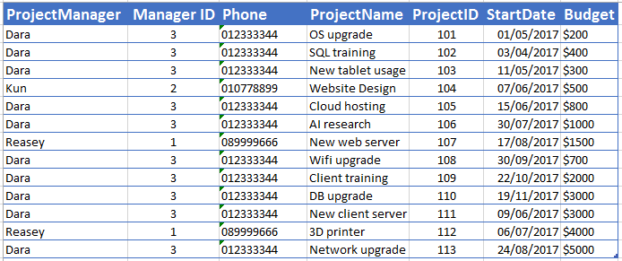
What is list?
List: a two dimensional of data
row and column like in excel file.
Notes:
5mn

Slide 8
Problems with lists: redundancy
Same data may be entered several times
Ex: a list of projects may include the project manager’s name, ID, and phone.
If a particular person is currently managing 10 projects, his or her information would appear in the list 10 times.
Notes:
List: 2d of data: row and column like in excel file. In a list each row is intended to stand on its own. As a result the same information may be entered several times
5mn

Slide 9
Notes:
So what will be the problem with this?
- It is redundant. We need more space.

Slide 10
Activity
Download excel file “Tutors List.xlsx” from google class room
Try to find at least 3 redundancies in the list
15 minutes
Notes:
-----end--------

Slide 11
Problems with lists: multiple themes
In a list each row may contain information on more than one theme or business concept
Ex: a list of projects may include project manager information (name, id, phone) and project information (projectname, id, startdate ,budget) in the same row
Notes:
Bz themes or concepts refer to a number of different attributes or properties that all naturally related to one type of business entity. For example: employee is a bz concept or entity that we want to keep track of its attributes (id, name, salary). Department, product, customer, order, location and so on so forth

Slide 12
Notes:
What would be the problem if we store information in this way?
The problem here is not about how we store the information but what might be happened to the information if we store it in this way?
It cause modification issues

Slide 13
Activity
With the same excel file “Tutors List.xlsx”
Try to find multiple themes in the list
15 minutes

Slide 14
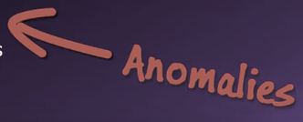
List modification issues
Redundancy and multiple themes in the lists create modification problems
Deletion problem
Update problem
Insertion problem
Notes:
We will introduce the possibility of data anomalies

Slide 15
Update problem
Notes:
1st case: suppose we want to change phone number of Manager Dara
We need to maintain the overall quality of data what we call data integrity we also need to update all related row.
One changes happen coz many updates ->update problems or anomalies

Slide 16
Activity
With the same excel file “Tutors List.xlsx”
Try to find update problem/anomaly in the list
05 minutes

Slide 17
Deletion problem
Notes:
Imagine if we want to delete chip let’s say he decide to drop out from the university so we need to remove chip from our list of student.
Now look will happen if we delete that row of data?
We are not only loose the information of that student but we also lost the adviser information and the department that the adviser works. U can notice that adviser tram is not assigned to any other student. So if we delete this row of data we may entirely loose the knowledge that adviser tram never been exist so it will be a problem. -> deletion problem

Slide 18
Activity
With the same excel file “Tutors List.xlsx”
Try to find deletion problem/anomaly in the list
05 minutes

Slide 19
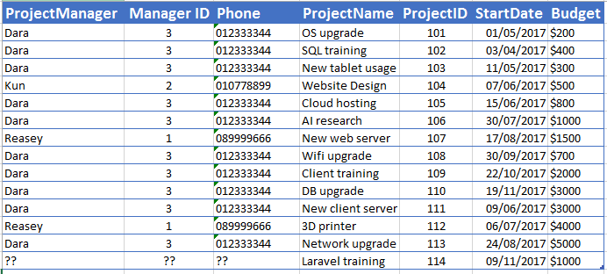
Insertion problem
Notes:
Let’s say our university decide to add new department
We create biology department. Well that’s fine we added into the department field along with the admin lastname. However we have empty cell there is no information for student no information for adviser. It means data are missing we aren’t effeceincy using our storage space. -> insertion problem

Slide 20
Activity
With the same excel file “Tutors List.xlsx”
Try to find insertion problem/anomaly in the list
05 minutes

Slide 21
Addressing information complexities
Relational Database are designed to address many of the information complexity issues that arise in business
Not only solve the problem with list but also to model those relationship among data
Notes:
Natrual complexity of relationship among bz data

Slide 22

Relational Database
Store data in table
Field/Column
Record/Row
Notes:
A table is 2d grid of data that contains columns and rows
The convention in database world is that
Column: represent different attributes of an entity
Row represent an instance of the entity

Slide 23
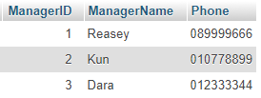
Notes:
List these 3 attributes as column in the table and each row in the table will represent the individual employee

Slide 24
Relational db
Store data in table
Relational db will break up a list into several parts
One part for each theme in the list
Ex: project list might be divided into a manager table, and a project table..
Notes:
We mentioned the natural relationship among bz concept out there in the bz world.
In relational db data in this concept will store in its own table.
So will might have employee table, department table, project table then we can create relationship between those table to figure out which employee work in which department
So instead storing all these information in big list we break information apart into pieces according to which information associate which bz theme or concept

Slide 25
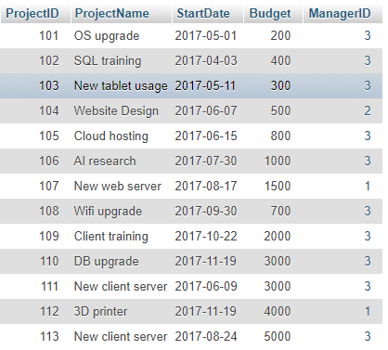
Notes:
So manager information goes to manager table and project goes to project table

Slide 26
Join operation
Putting pieces back together
Notes:
Somehow tables must be joined back together to get the complete information
Why?
How?
Let’s see example

Slide 27
Notes:
Place managerid in project table and then we could use these id in each table to link related row together

Slide 28
SQL/siːkwəl/
Structure Query Language
Most of relational Database support SQL: simple to use and simple to understand
Performing 4 basic operations on data
Create
Read
Update
Delete
Notes:
Sql or sequel if you like
We will learn it later in the course within a few weeks\
If you understand it clearly no doubt to work with any kind of db will a short learning curve

Slide 29
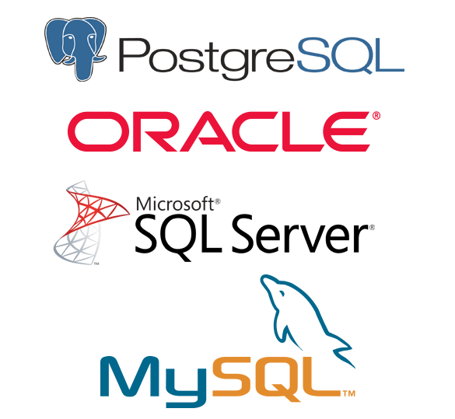
DBMS
Acts as gate keeper: maintain quality of Database
Control and manage the operations of Database
Software program to creates, processes and administers the Databases
Notes:
It isn’t db but interact with db
Dbms: act as gate keeper: maintain quality of db

Slide 30
Functions of DBMS
Create Database
Create tables
Establish relationship between tables
CRUD
Provide security
Back up and recovery
Notes:
What can dbms do for us

Slide 31
Database
Database : actually store data in tables, it contains metadata
Metadata: data which describes other data structure in Database
Integer
Notes:
Schema: structure of tables

Slide 32
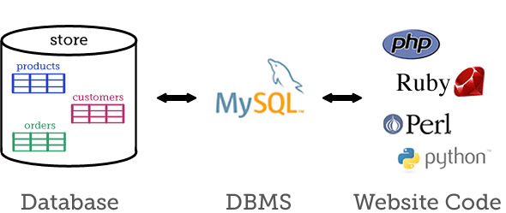

Slide 33
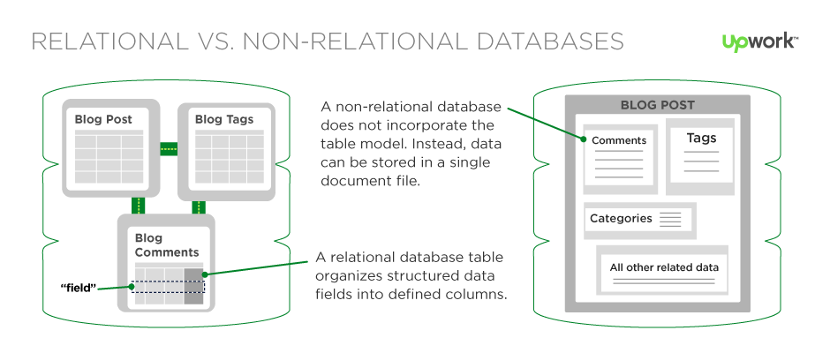
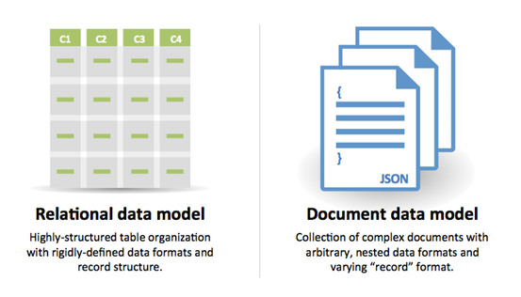
Relational vs Non Relational Database
Notes:
Structured Query Language as the standardized programming language for managing relational databases as well as for performing various operations on the data in them. Whereas, NoSQL databases typically do no use tabular relations for storage and retrieval of data that are common in relational databases. Instead they are document based that store key-value pairs, graph databases or wide-column stores. NoSQL are focused primarily on the collection of documents. It is also due to this that NoSQL are ideally used to store large set of data which are commonly stored in JSON documents.

Slide 34



Slide 35

Notes:
---5mn

